Slide 1
Strategies for Customer Acquisition and Retention Unit 2 Discussion

Slide 2

Organizations employ a variety of strategies to prospect for new customers

Slide 3

One common approach is content marketing, where valuable and relevant content, such as blog posts, videos, and webinars, is created to attract potential customers to their website or social media platforms.

Slide 4
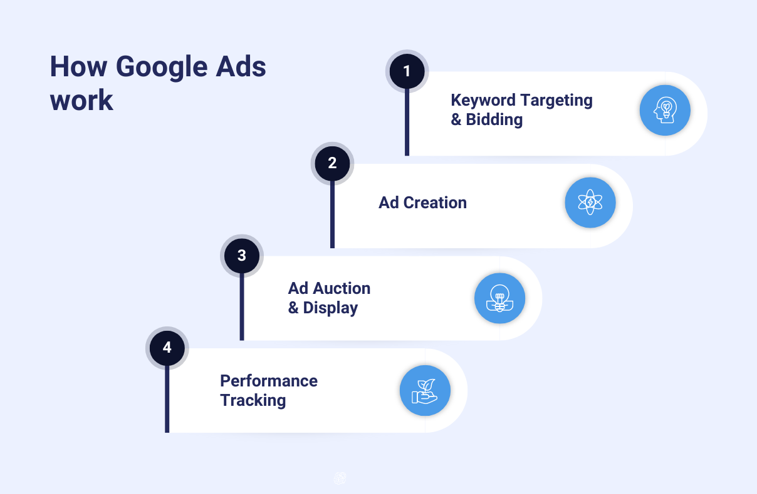
Another strategy is targeted advertising, using online platforms like Google Ads or social media advertising to reach specific demographics or industries.

Slide 5

Make eye contact with your audience to create a sense of intimacy and Sales teams also engage in direct prospecting through cold calling, email outreach, and attending industry events.

Slide 6

Networking and referrals are also powerful tools, leveraging existing relationships to generate new leads.

Slide 7

Additionally, organizations may offer free trials or demos to entice potential customers to experience their products or services firsthand.

Slide 8
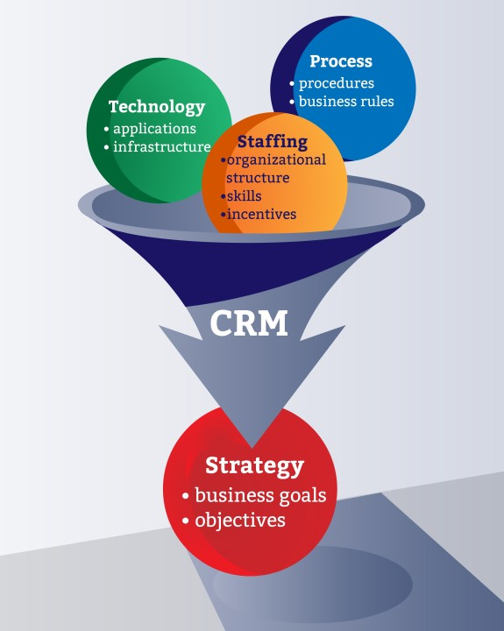
CRMs and Business Analysts play crucial roles in supporting these prospecting strategies. A CRM system acts as a central repository for customer data, enabling organizations to track leads, manage interactions, and segment potential customers based on various criteria.

Slide 9

Business Analysts can leverage CRM data to analyze customer behavior, identify trends, and develop targeted marketing campaigns.

Slide 10

Analysis can then inform targeted content creation or sales strategies.

Slide 11

Also, CRMs can automate tasks such as lead scoring and email follow-ups, freeing up sales teams to focus on building relationships with potential customers.

Slide 12
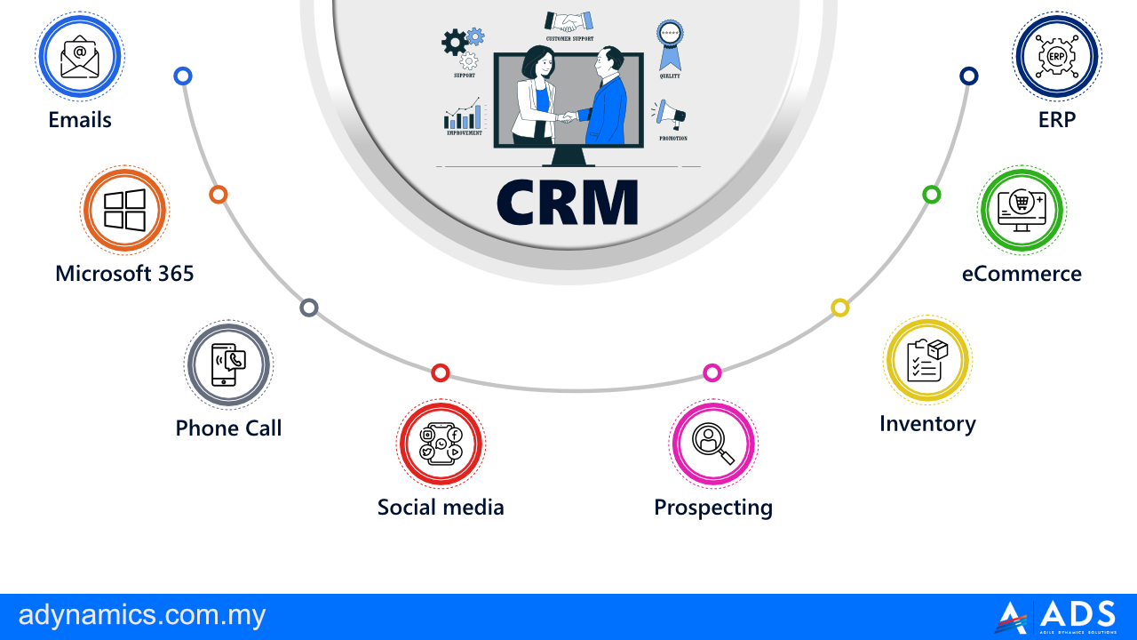
By integrating CRM data with other business systems, Business Analysts can provide valuable insights into customer acquisition costs and the effectiveness of different prospecting strategies, ultimately contributing to more efficient and successful customer acquisition efforts.

Slide 13
Thank you
Gordon Elliott Williams
BIA540-30
Customer Relationship Management
Unit 2 Discussion
Dr. M. Saxton

